Slide 1
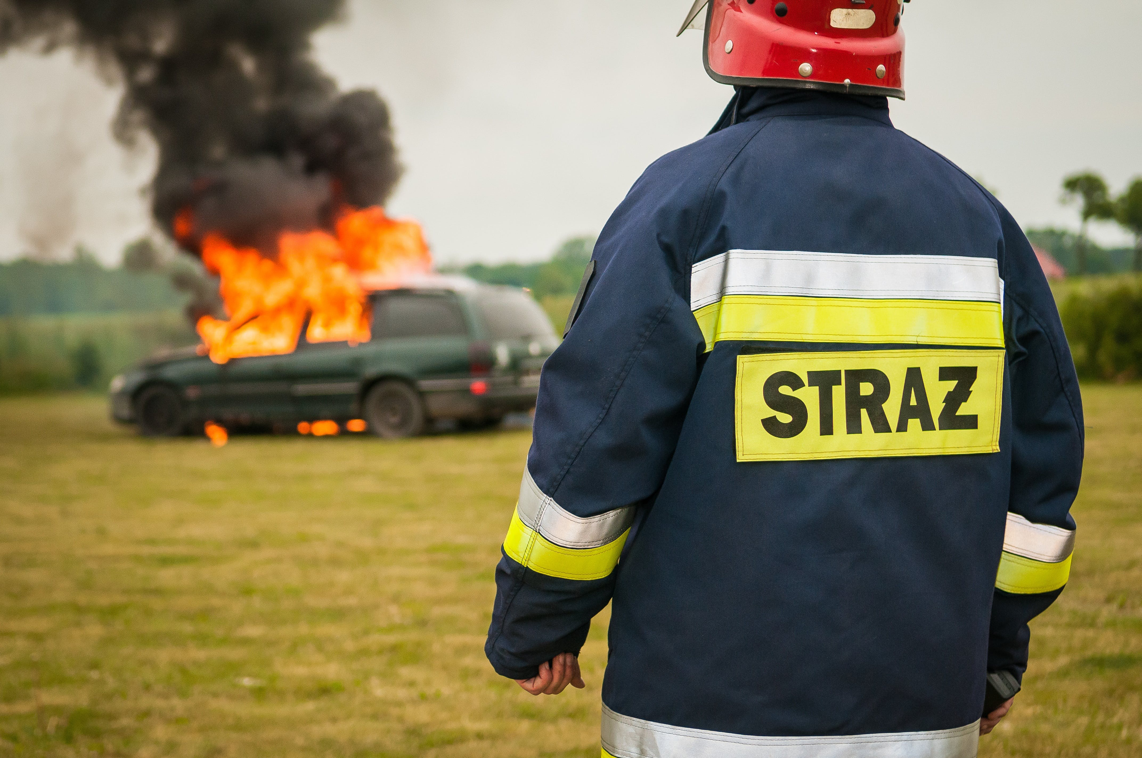
PHASE III
CHICAGO CAR CRASHES
GROUP SEVENTEEN
Caroline Mbugua
Dianna Wangura
Eunita Kolusi
Mark Kuria
Mlati Ochieng'
Rhoda Musyoki

Slide 2

INTRODUCTION
DATASETS:
We fetched crash data from E-Crash showing information about each traffic crash on city streets within the City of Chicago limits and under the jurisdiction of Chicago Police Department (CPD). Data is shown as is from the electronic crash reporting system (E-Crash) at CPD, excluding any personally identifiable information. Records are added to the data portal when a crash report is finalized or when amendments are made to an existing report in E-Crash.
Traffic Crashes- Vehicle
Traffic Crashes- People

Slide 3
CONTENTS:
2. Business understanding
1. Addressing Research Questions
3. Findings
5. Visualizations
4. Conclusion and Recommendations

Slide 4

01
Addressing Research Questions
Build a classifier to predict the primary contributory cause of a car accident, given information about the car, the people in the car, the road conditions etc.

Slide 5
YOUR TITLE HERE
Problem Statement: Vehicle Safety Board of Chicago working with the insurance stakeholder are launching a campaign to reduce car crashes in the city. They would like to determine which car crashes are preventable and which are not. Specifically: Preventable Crashes: These accidents could have easily been avoided. They typically result from not following traffic laws or negligent driving.
01
Stakeholder: The primary stakeholder in this scenario is the Vehicle Safety Board of Chicago. They are launching a new campaign with the goal of reducing car crashes in the city.
02
03
Presentations are communication tools that can be used as speeches, reports, and more.

Slide 6

02
Business Understanding
Business Problem: The business problem revolves around determining which car crashes are preventable and which are not. Specifically: Preventable Crashes: These are accidents that could have easily been avoided. They typically result from factors such as not following traffic laws or negligent driving.

Slide 7
YOUR TITLE HERE
Presentations are communication tools that can be used as speeches, reports, and more.
01
Presentations are communication tools that can be used as speeches, reports, and more.
02
03
Presentations are communication tools that can be used as speeches, reports, and more.

Slide 8

03
Findings
Build a classifier to predict the primary contributory cause of a car accident, given information about the car, the people in the car, the road conditions etc.

Slide 9
YOUR TITLE HERE
Presentations are communication tools that can be used as speeches, reports, and more.
01
Presentations are communication tools that can be used as speeches, reports, and more.
02
03
Presentations are communication tools that can be used as speeches, reports, and more.

Slide 10
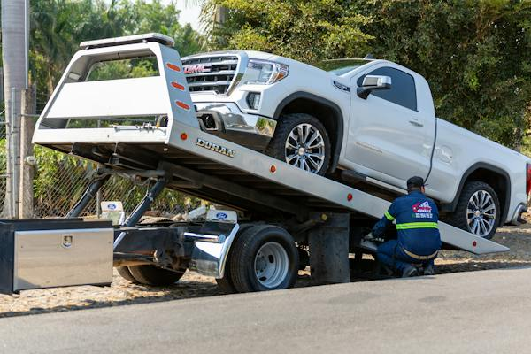
04
Conclusion and Recommendations
Build a classifier to predict the primary contributory cause of a car accident, given information about the car, the people in the car, the road conditions etc.

Slide 11
YOUR TITLE HERE
Presentations are communication tools that can be used as speeches, reports, and more.
01
Presentations are communication tools that can be used as speeches, reports, and more.
02
03
Presentations are communication tools that can be used as speeches, reports, and more.

Slide 12

05
Visualizations
Build a classifier to predict the primary contributory cause of a car accident, given information about the car, the people in the car, the road conditions etc.

Slide 13
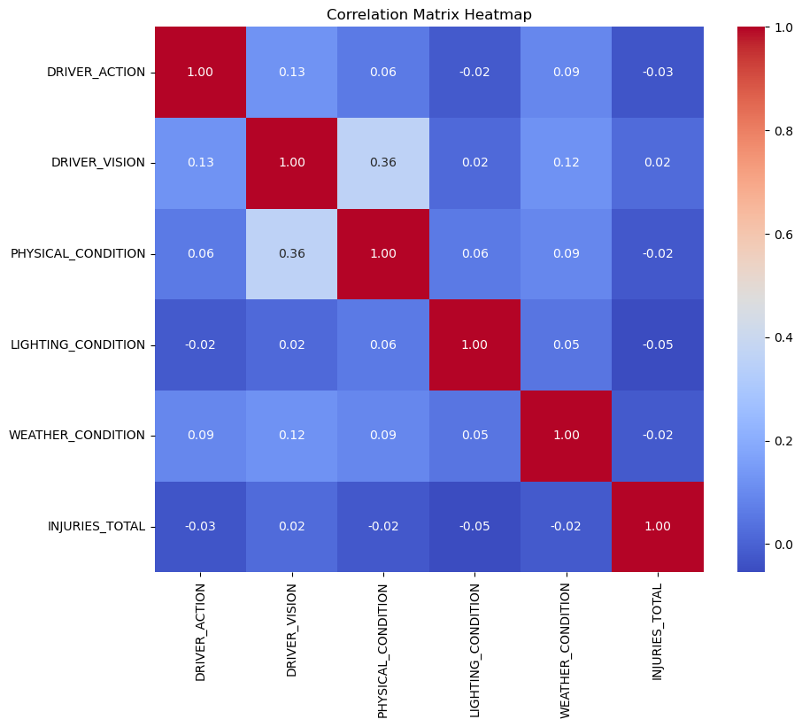
Correlation Matrix Heatmap

Slide 14
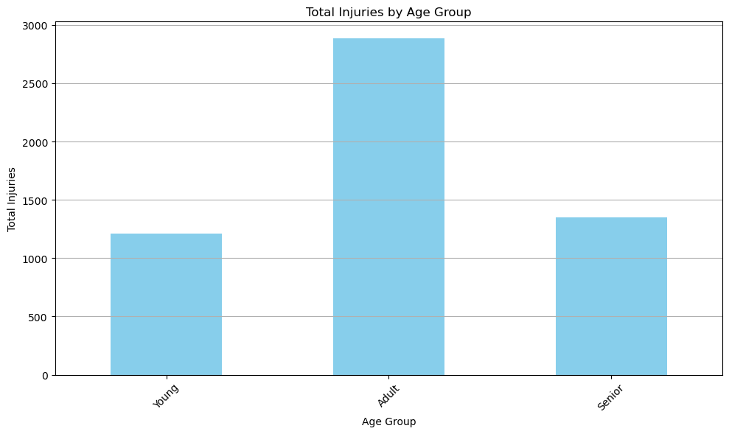
Total Injuries By Age Group

Slide 15
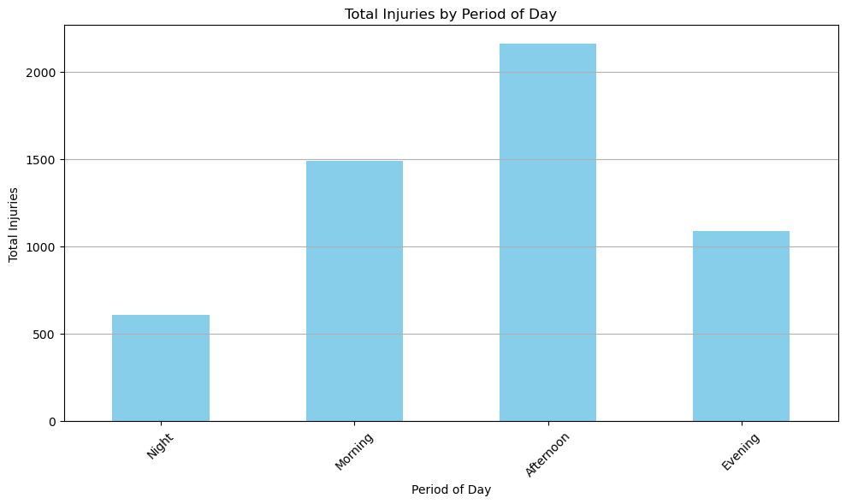
Total Injuries By Peririod of Day

Slide 16
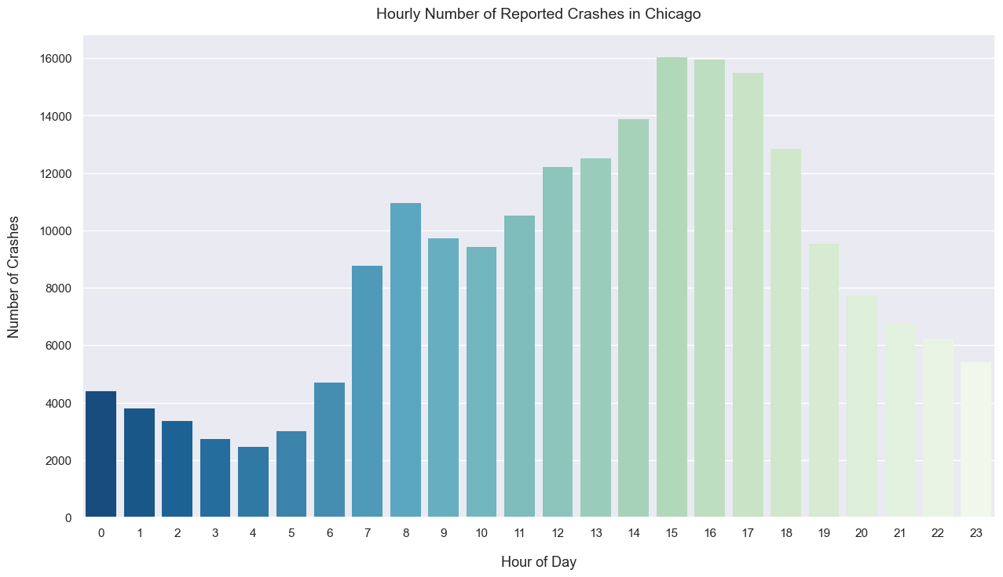
Hourly Number of Reported Crashes in Chicago

Slide 17
YOUR TITLE HERE
Presentations are communication tools.
Topic
Topic
Presentations are communication tools.
Topic
Presentations are communication tools.
Topic
Presentations are communication tools.
Topic
Presentations are communication tools.

Slide 18

YOUR TITLE HERE
Your Title Here
Your Title Here
Presentations are communication tools.
Presentations are communication tools.
Your Title Here
Presentations are communication tools.
Your Title Here
Presentations are communication tools.
Your Title Here
Presentations are communication tools.

Slide 19
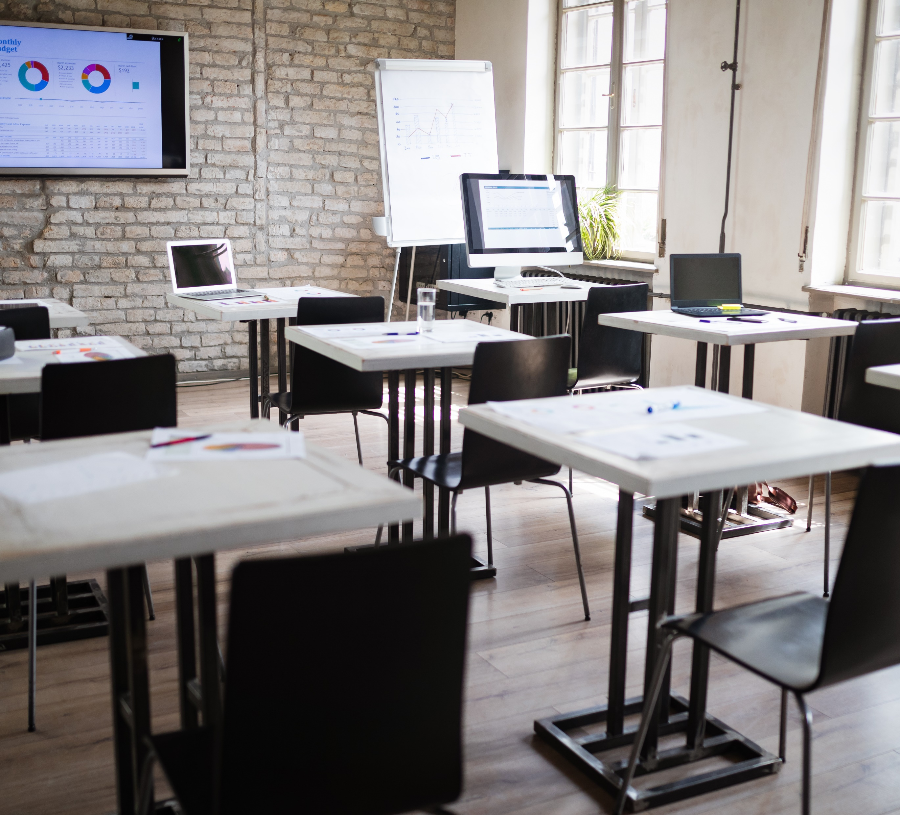
Topic
YOUR TITLE HERE
Topic
Topic

Slide 20

YOUR TITLE HERE
Your Title Here
Presentations are communication tools that can be used as demonstrations.
Your Title Here
Presentations are communication tools that can be used as demonstrations.

Slide 21
YOUR TITLE HERE
Your Title Here
Your Title Here
Presentations are communication tools that can be used as demonstrations.
Presentations are communication tools that can be used as demonstrations.
Presentations are communication tools that can be used as demonstrations.
Presentations are communication tools that can be used as demonstrations.
Presentations are communication tools that can be used as demonstrations.
Presentations are communication tools that can be used as demonstrations.
Presentations are communication tools that can be used as demonstrations.
Presentations are communication tools that can be used as demonstrations.

Slide 22
CONTENTS
YOUR TITLE HERE
YOUR TITLE HERE
Add a short description
Add a short description
YOUR TITLE HERE
YOUR TITLE HERE
Add a short description
Add a short description

Slide 23
Topic
YOUR TITLE HERE
Topic
Topic

Slide 24
YOUR TITLE HERE
Topic
Topic
Topic
Topic
Presentations are communication tools.
Presentations are communication tools.
Presentations are communication tools.
Presentations are communication tools.

Slide 25
YOUR TITLE HERE
1
3
5
Topic
Topic
Words are your thoughts In order to demonstrate the good effect of publishing, please explain your point of view concisely
Topic
Presentations are communication tools.
Presentations are communication tools.
please enter your title
Words are your thoughts In order to demonstrate the good effect of publishing, please explain your point of view concisely
PART
PART
PART
Presentations are communication tools.
2
Topic
4
Topic
6
Topic
PART
Presentations are communication tools.
PART
Presentations are communication tools.
PART
Presentations are communication tools.

Slide 26
Topic
YOUR TITLE HERE
Topic
Topic

Slide 27
YOUR TITLE HERE
Topic
Topic
Topic
Topic
Topic
Presentations are communication tools.
Presentations are communication tools.
Presentations are communication tools.
Presentations are communication tools.
Presentations are communication tools.

Slide 28
YOUR TITLE HERE
Topic
Theory and Research Methods
please enter your title
Words are your thoughts In order to demonstrate the good effect of publishing, please explain your point of view concisely
01
02
Topic
03
Topic

Slide 29
YOUR TITLE HERE
Presentations are communication tools that can be used as speeches, reports, and more.
Your Title Here
Presentations are communication tools that can be used as speeches, reports, and more.
Your Title Here
Presentations are communication tools that can be used as speeches, reports, and more.
Your Title Here
Presentations are communication tools that can be used as speeches, reports, and more.
Your Title Here

Slide 30
YOUR TITLE HERE
It serves a variety of purposes, making presentations powerful tools for convincing and teaching.
Your Title Here
Your Title Here
Presentations are communication tools.
Presentations are communication tools.
Your Title Here
Your Title Here
Topic
Presentations are communication tools.
Presentations are communication tools.

Slide 31

YOUR TITLE HERE
Presentation are communication tools that can be used as demontrations, lectures, reports, and more. it is mostly presented before an audience.
Presentations are communication tools.

Slide 32
YOUR TITLE HERE
Presentations are communication tools.
Presentations are communication tools.
Presentations are communication tools.
Presentations are communication tools.
Presentations are communication tools.
Presentations are communication tools.

Slide 33
THANK
YOU
Project: Chicago Car Crashes
Group: 17

